Slide 1
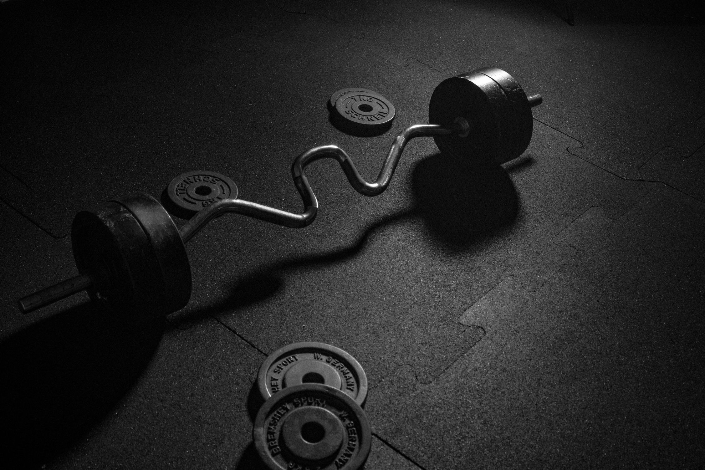

PRIME
FITNESS
PRIME YOUR FITNESS. PRIME YOUR LIFE.
CREDIT:
ISLAM AYMAN
YOUSSEF YASSER
KENZY HAZEM
ROMANY NAZMY

Slide 2

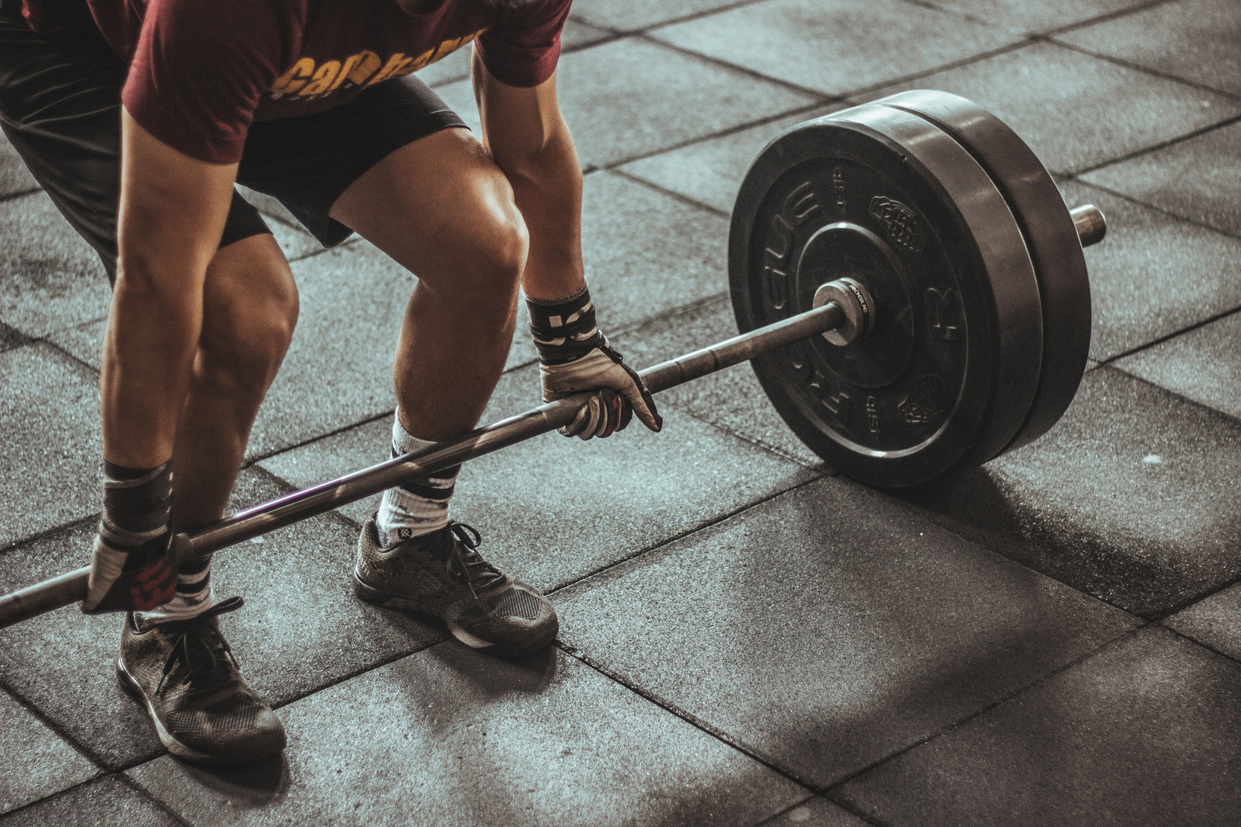

WelcoME To Our
CAMPAING

Slide 3
Table Of Content
ABOUT US
OUR MOODBOARD
VISION AND MISSION
TARGET DYMOGRAHIP
MARKETING METHODS
How to find us
CONUCLOUSION

Slide 4

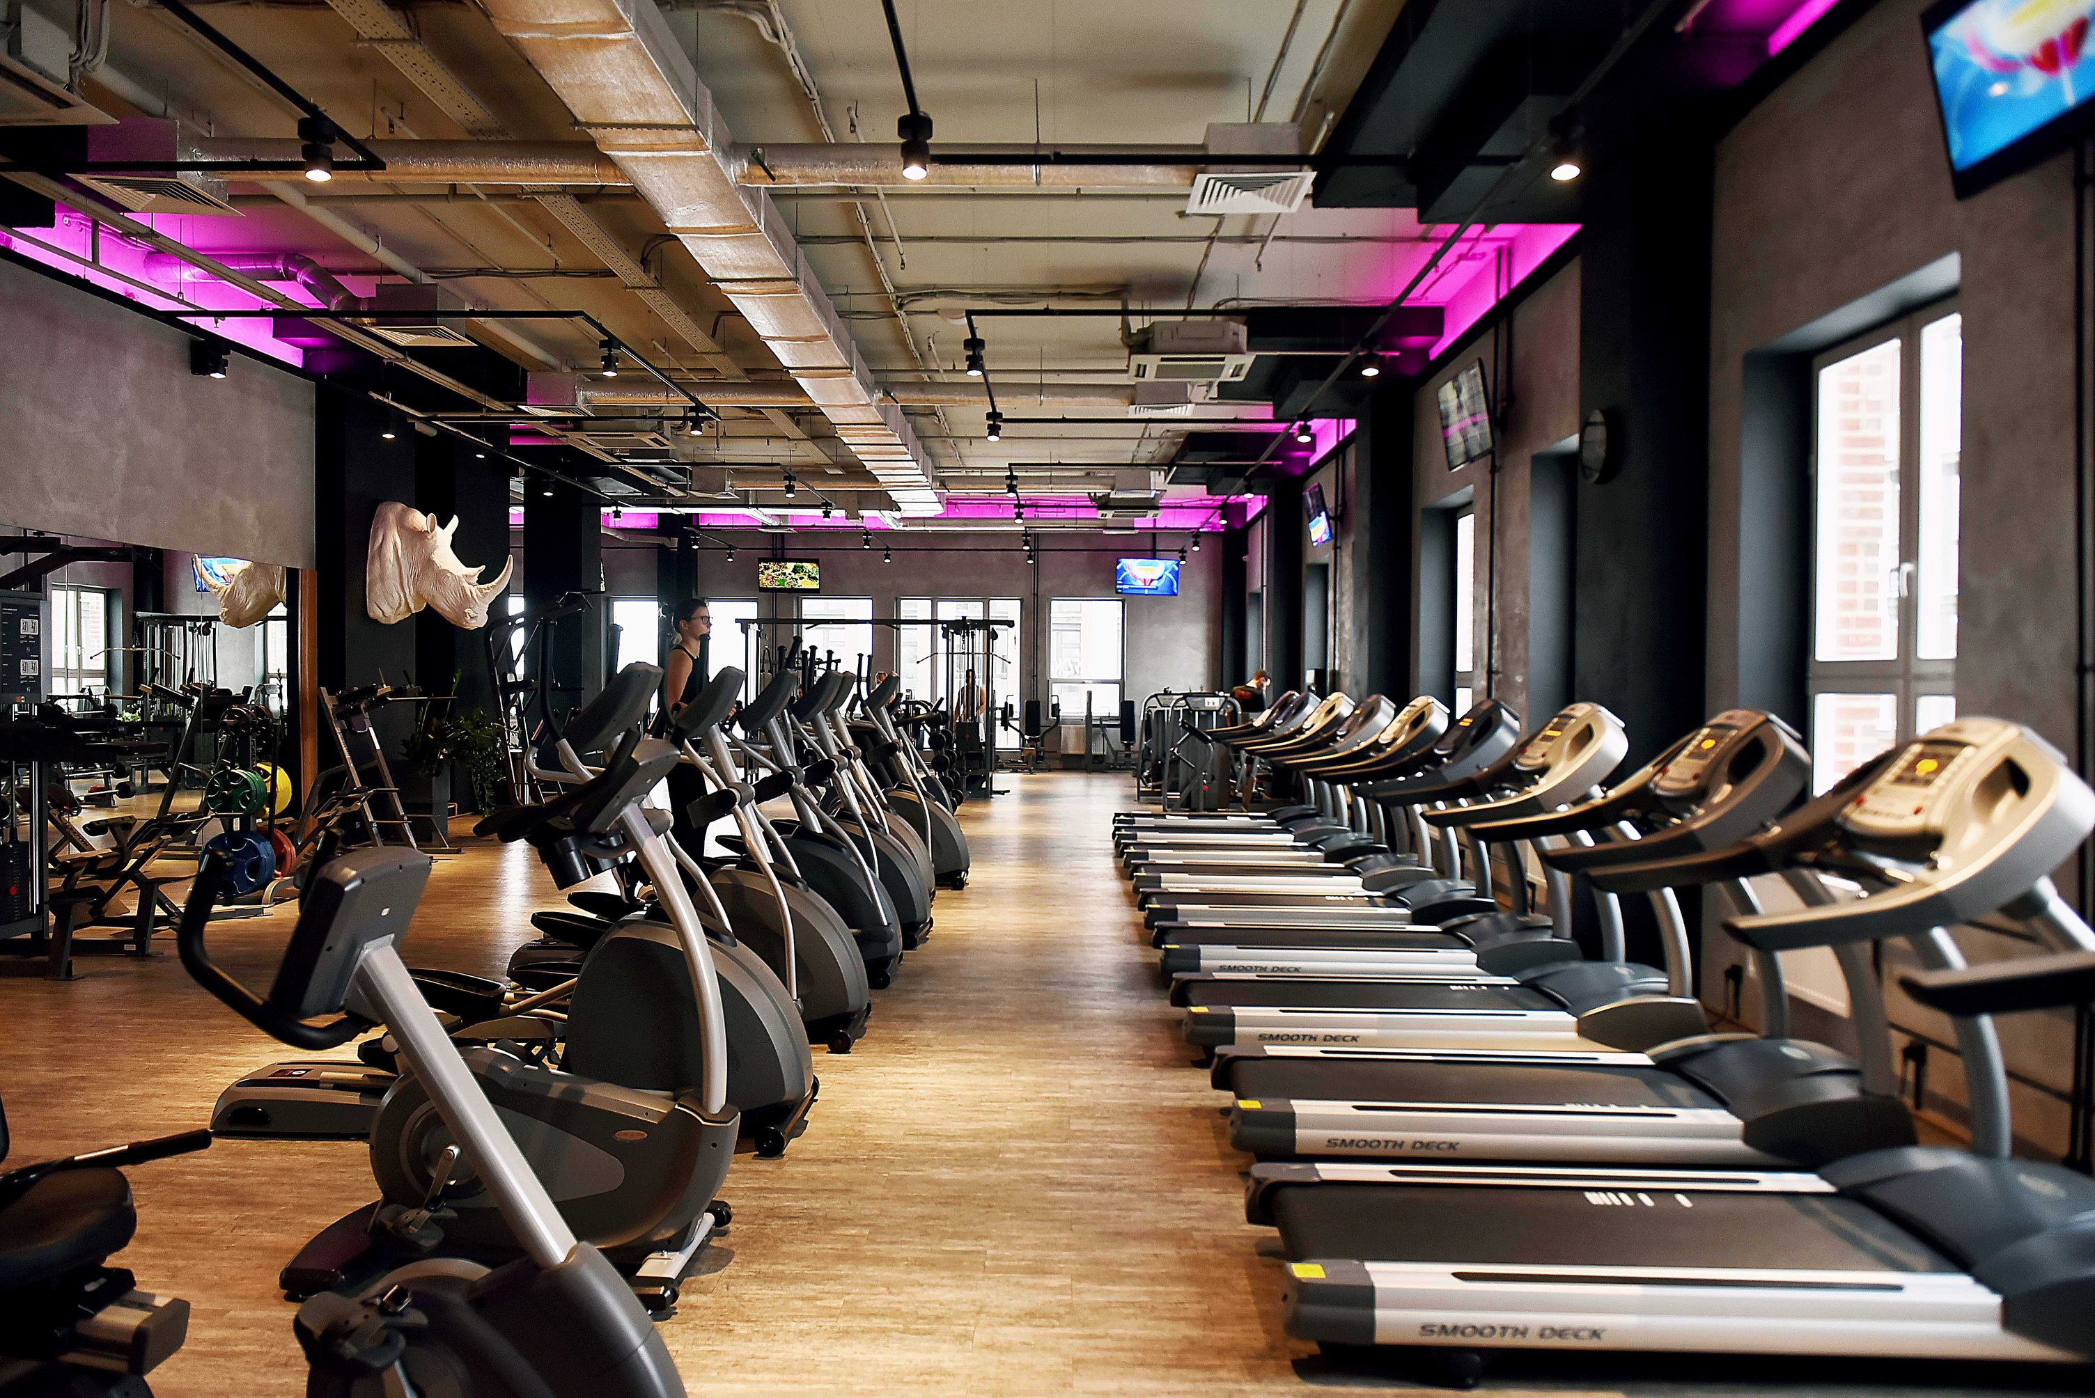
We at prime fitness believe that your fitness is as important as anything else in your life that is why we decided to help you to achieve your prime fitness.
What TO Know About Us?

Slide 5



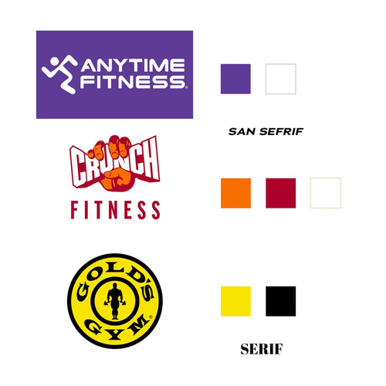

OUR MOODBOARD:

Slide 6

Our campaign Vision
And Mission
01. Vision
02. Mission
here in prime fitness believe that everyone
deserve a chance to take care of themselves and help them lead a better and healthy life.
we look to help them get on the right path to take care of themselves by providing them the access to a wide variety of tools and places for them to start take care of themselves

Slide 7
03. TARGET DYMOGRAOHIC :
after looking at the statistics we accumulated that people between 15-30 do the least amount of exercise, while another study showed as that 80,2% of Egyptians between the ages of 20-24 never actually exercise and if you ask why are they our target demographic because:
they spend most of there time on social media which make them a perfect choice for our marketing team to influence them to start exercise and start focusing on their health
and that brings us to our marketing methods:

Slide 8

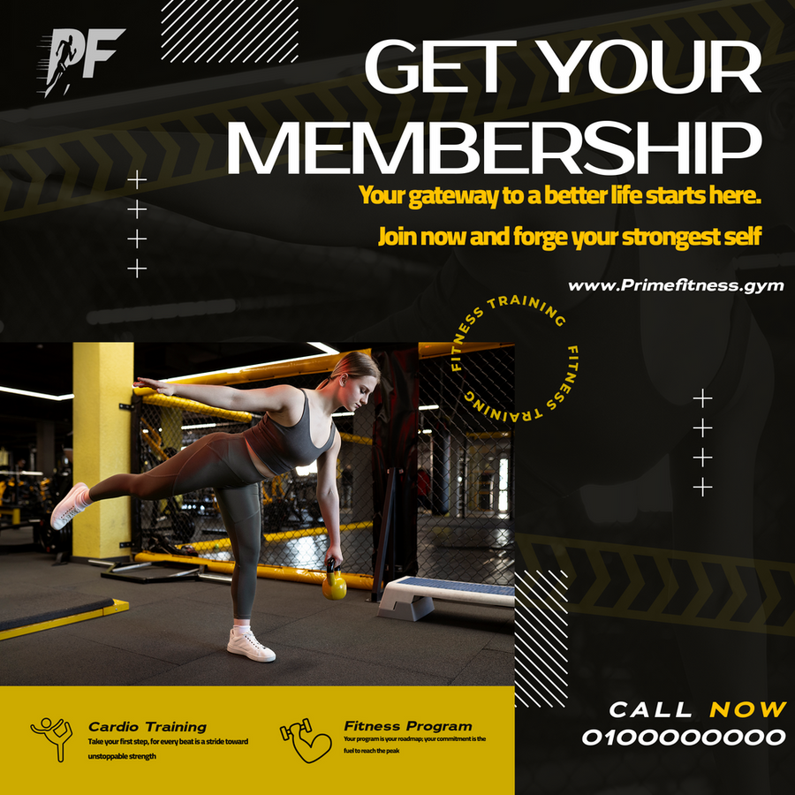
4. marketing methods:
we primarily focused in four marketing methods:
1.
social media ads:

Slide 9

2. flyers :

Slide 10

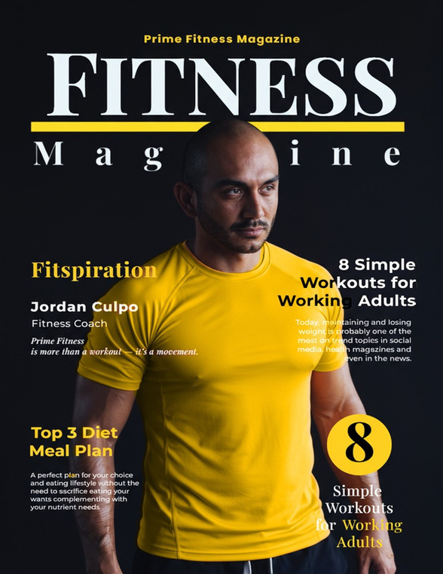

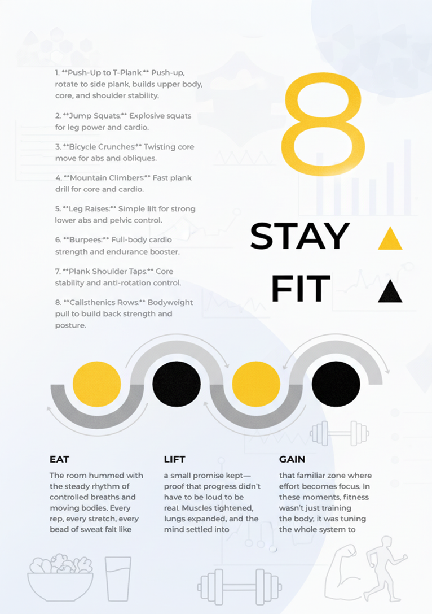
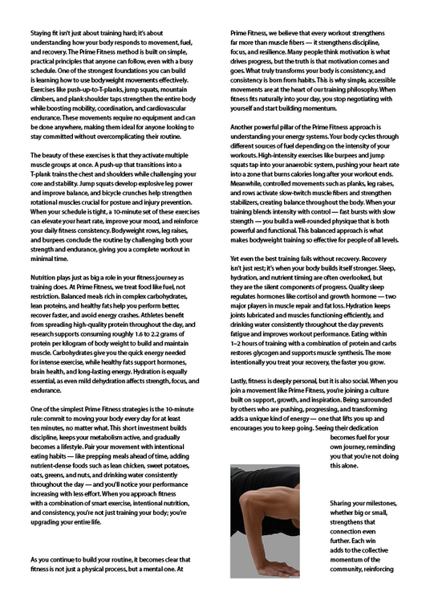
4. magazines:

Slide 11
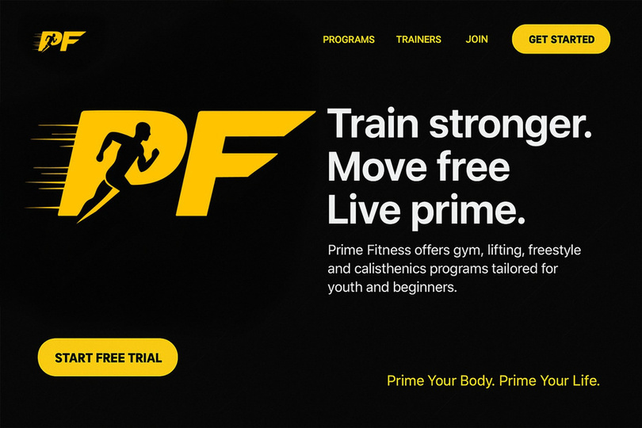
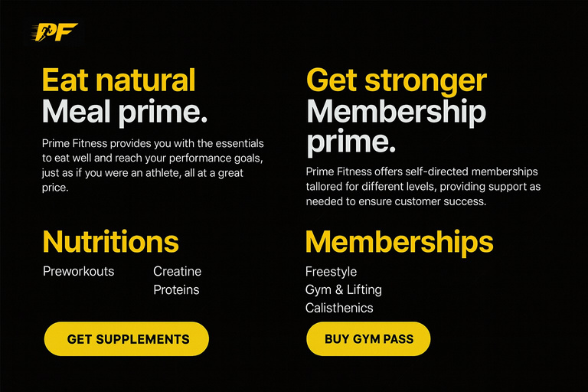
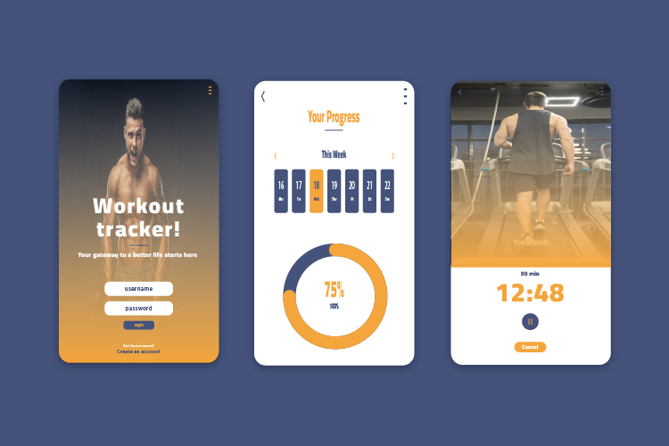
5.how to find us:
our official
website:
our mobile app:

Slide 12




Get in Touch
0123456789
primefitness@email.com
www.primefitness.net
xxx-xxxx-xxxx

Slide 13
Thank You
FOR YOUR ATTENTION

